Slide 1
System and Network Administration
Introduction & Overview

Slide 2
A Philosophy
System Administration is about
Putting together a network of computers
Getting them to run some applications
Keeping them running in a dynamic world
System Administration is as much about technology as it is about user behaviour
System Administration requires constant monitoring and rapid response to problems

Slide 3
Network & System Administration
Put together a network of computers
Get them running
Keep them running (despite Users….)
Provide a Service to Users
Requires skills of
Mechanic
Sociologist
Researcher
Notes:
FIT2018 Network Admin - Role of Network Administrator
3/09/2020
FIT2018 (c) Monash University
3

Slide 4
Challenges
Deploy and update many machines
Understand how services support business tasks
Plan and implement adequate security
Be able to fix errors and problems
Keep track of and be able to use knowledge
Provide comfortable environment for users
Notes:
This is more than just about installing computers and networks
planning and
designing
an efficient community of computers that allow users to get their jobs done.
Designing logical, efficient networks
Deploying and updating many machines
Deciding what servers are needed, and limits thereof
Plan and implement security
Give users an environment that they need to be productive and comfortable
Troubleshooting: detecting and fixing errors
Keep track of new technology and knowledge
FIT2018 Network Admin - Role of Network Administrator
3/09/2020
FIT2018 (c) Monash University
4

Slide 5
Systems & Network Administrator Skills
Unix/Windows usage, installation, configuration
Shell utilities and script programming
C and how to use make
Network: TCP/IP, Ethernet, hardware
Infrastructure services: DNS, DHCP
Shared storage: NFS, CIFS
Directory services: LDAP, Active Directory, NIS
User services: web, mail, database, groupware
System tuning and accounting
Security consciousness
Notes:
It’s a sad state of affairs that Unix provides a tougher interface to get used to.
But Windows has a long way to go in many ways:
Performance
Security
Flexibility and portability
It is possible, of course, to run a network of Windows servers.
But Unix servers (Solaris, Linux, FreeBSD) are considered to be better, in general.
Building packages from source (C programs) is generally desirable.
Of course, Novell Netware should not be ignored.
FIT2018 Network Admin - Role of Network Administrator
3/09/2020
FIT2018 (c) Monash University
5

Slide 6
Outcomes
Successful completion of this module means you will be able to:
Explain the role and operation of each of the software components essential to a corporate networked information system
Evaluate proposed improvements to the configuration of a corporate networked information system and the associated administration policies and procedures
Integrate DNS, DHCP, email, web, LDAP, and SSL to create a working system
Combine new elements into the basic system to meet the needs of diverse communities of interest

Slide 7




Slide 8
Theme: Virtualization
One physical machine running a host OS, with one or more virtual machines running a possibly different guest operating system
Example:
Hardware: blade server, 64-core Intel, 64 GB RAM
OS: Red Hat Enterprise Linux
Virtualization Platform: Xen
Virtual machines: 32 configured as a cluster
This is the main idea
of Cloud Computing
Lower cost of ownership
labor costs
capital expenditure
power consumption
rack space

Slide 9
Virtual Networking
Physical
Network
Interface
VirtualBox Environment
Logical
Interface
Device
Driver
VM
Logical
Interface
Logical
Interface
VM
Host Operating
System
Logical
Interface
Virtual
Hub
VM
Built-in DHCP
Built-in NAT

Slide 10
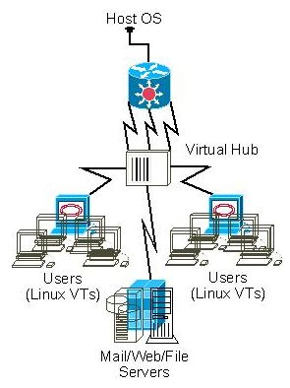
VirtualBox “Virtual Physical” Architecture
Real subnets with real software, virtual wiring
Can we actually say that?
Think of it this way:
Would you expect to be able to paste what you copied if you had
to change chairs to be in front of the screen, mouse, and keyboard?
That is what virtual means:
It acts like a real, separate machine but it runs in a window
How Nice Is That ... real systems with virtual hardware (VTs) and virtual connections (wires)

Slide 11
TinyNet: Virtualization
Philosophy:
One service, one server
Minimal server footprint – 128mb RAM, 200mb storage
- run a 4-5 node network on a 4gb RAM Windows host
- store everything on a 2gb thumbdrive
Open source, easy to replicate and configure
- (Sun) VirtualBox
- Standard linux distribution: Slackware
Tool for learning and understanding
- curses interface, de-referenced scripts
- buggy pre-configuration to provide good examples

Slide 12
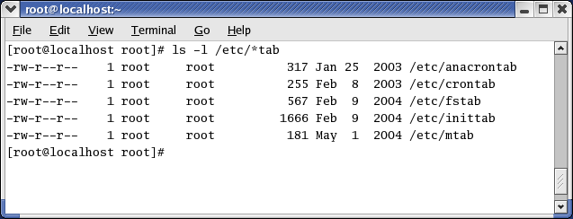
Because of Linux’s UNIX roots, the primary method by which it is administered is the command line.
Commands are often followed by switches, which allow different options to be used.
All administrative tasks can be performed from the command line, either by issuing specific commands or editing text-based Scripts written to automate tasks. configuration files.

Slide 13
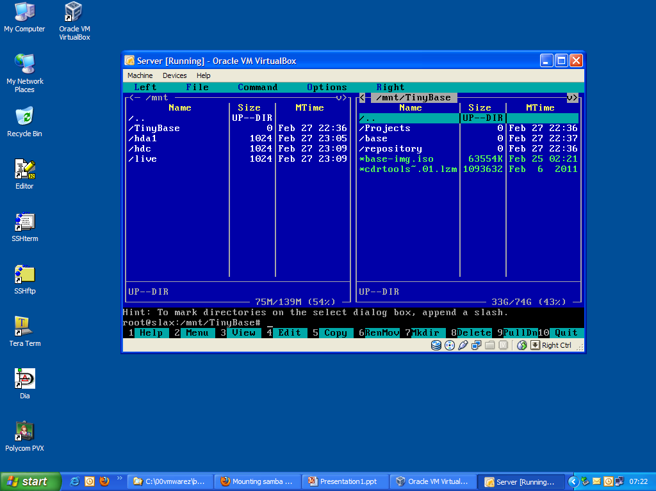
Most Linux distributions have GUI configuration utilities as well.
These are usually just a thin layer of interpreted code that calls the command line script
We strike a balance with utilities that have a user interface built on the curses libraries
This will get to be familiar
VM running the mc file manager –
One of the greatest linux utilities ever!

Slide 15
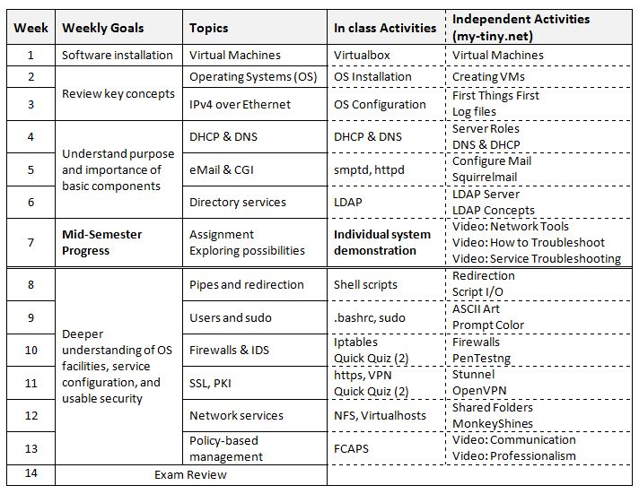

Slide 16
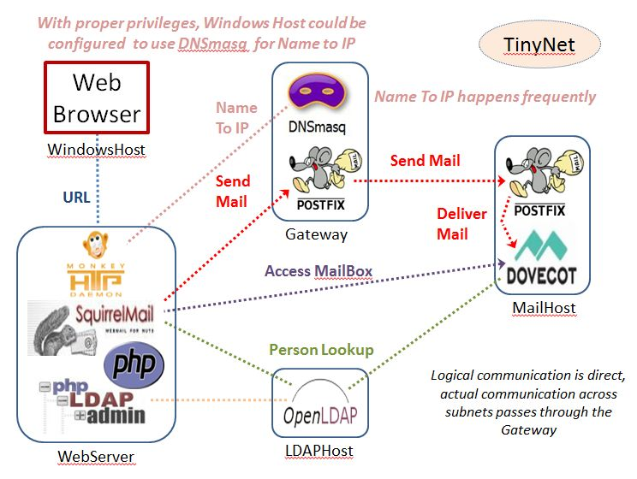
TinyNet: base configuration
Everything is built on a generic image
Pre-configuration is limited to what is necessary to overcome some environmental oddities
software is packaged to meet dependencies, ease installation

Slide 17
Getting Started
Virtualbox
Comes in two parts because of copyright
Platform Pack (main application)
Extension_Pack (licensed)
You must have Administrator privileges to install

Slide 18
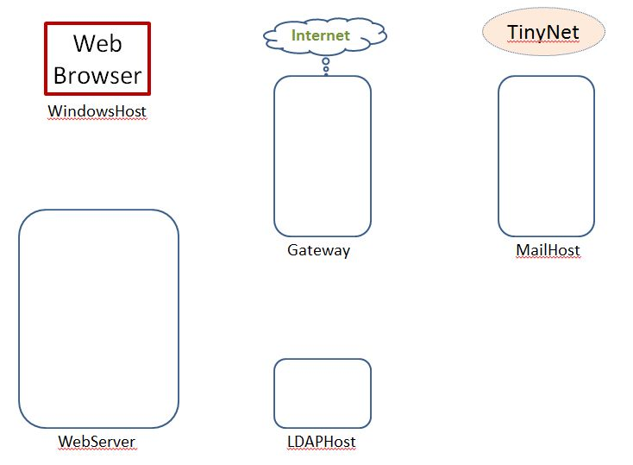
Getting Started
TinyNet
Comes in two parts
Base.iso (base image)
Config.iso (configuration and applications)
Create a virtual machine
Partition the disk
Create a filesystem
Copy the OS
Install the bootloader
Configure common services
Clone!
After installing VirtualBox, create VMs!
www.my-tiny.net

Slide 19
Setup VMs

Slide 20
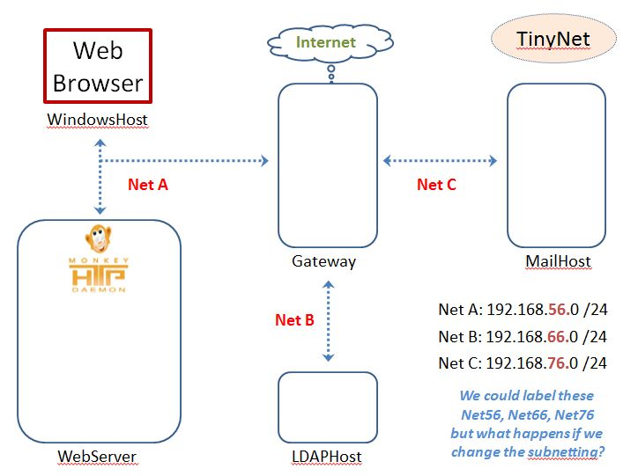
Network Hands-on

Slide 21
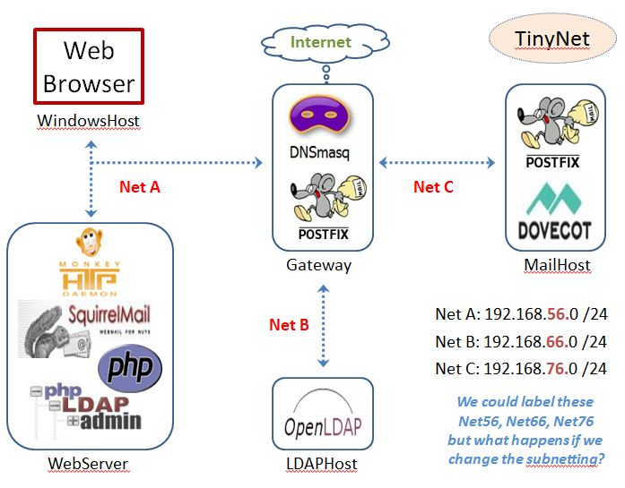
Configure Roles

Slide 22
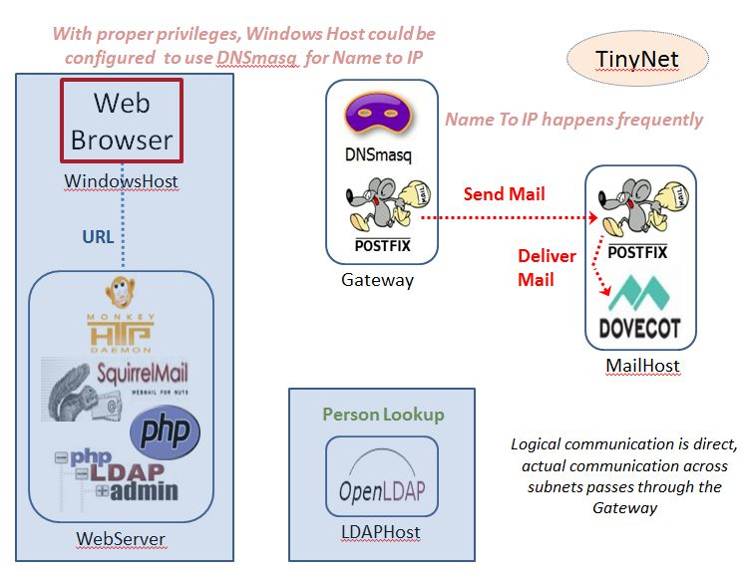
Configure Mail

Slide 23
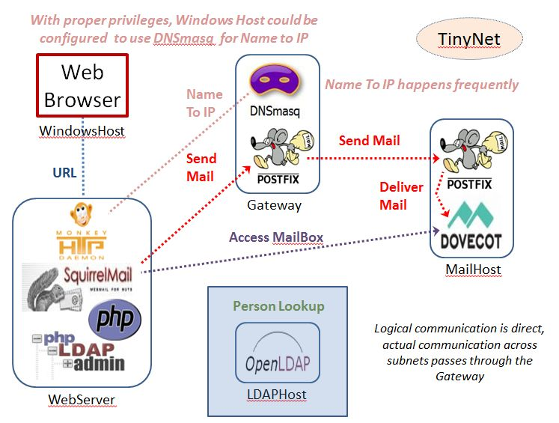
Configure Webmail

Slide 24
Configure LDAP

Slide 26
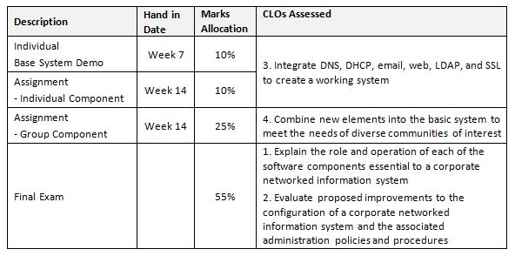
Assessment

Slide 27
Theme: Problem Solving
Having detected the fault or Problem
Isolate the problem and identify/define it
Use tests and tools to diagnose the problem
Solve the problem and document the solution
Prioritize multiple problems
Requires skills of
Mechanic
Sociologist
Researcher
Notes:
FIT2018 Network Admin - Role of Network Administrator
3/09/2020
FIT2018 (c) Monash University
27

Slide 28
Transferable skills
Know what you want, discover how
Being methodical, especially with troubleshooting
Lifelong learning – search and discover, don’t be intimidated
Cultural sensitivity – people do the same thing in different ways
Requires skills of
Mechanic
Sociologist
Researcher

Slide 29
Resources
Best General Linux Reference
RedHat 9 Guides - www.my-tiny.net
Close to our distribution – but different!
(our distribution is small, but has all the capabilities we need)
Be careful looking at documentation, instructions, configurations: they are different for different distributions
As you get familiar with what we have, you will be able to identify these differences and adapt
Celebrate
Diversity!

Slide 31
Caution!
Running VMs on a laptop:
Check your power settings – close lid, low battery, etc.
Never Hibernate, only Sleep
(“Hibernate” suspends too many host processes, and your VM will get corrupted – “Sleep” works well enough)
(or … just poweroff the VM)

Slide 32
Getting Started
Virtualbox
Comes in two parts because of copyright
Platform Pack (main application)
Extension_Pack (licensed)
You must have Administrator privileges to install
Decide what version; No need try to stay current
Hardware virtualization is Definitely ON in the BIOS – 6.1 +
Don’t know/don’t care about the BIOS – 6.0 July 2020
Exact match the user interface in the videos – 5.2 July 2020

Slide 33
Getting Started
Virtualbox
Use version 6.0 if you need to run VMs with software virtualization, as this has been discontinued in 6.1
Version 6.1.= requires VT-x/AMD-v to be available
https://forums.virtualbox.org/viewtopic.php?f=1&t=62339
Every version requires hardware support for virtualization (Intel VT-x or AMD-v) in order to run 64bit VMs, and any VM that uses more than one CPU core.

Slide 34
TinyNet: linux 2.6/3x/4x/ (32-bit)
When creating a VM, make sure you choose the proper version of the guest OS template in
<VM Settings> | General | Basic | Version,
Choosing the correct template allows other modern processor features to be visible to the guest - it's not just about 64bit capability any more.
If Create VM only shows 32 bit, hardware virtualization is OFF
This works fine for TinyNet with Virtualbox 5.x and 6.0

Slide 35
Getting Started
BIOS Settings
You need to enable Intel VT-x or AMD-v in the host PC BIOS.
Note your exact system model, then go online and check how to get into the BIOS settings at boot time.
Once you get there you need to look for something buried in a menu
Usually under CPU Settings, possibly in the security category.

Slide 36
Getting Started
BIOS Settings
The option should be called something like "Enable Virtualization Technology", "Secure Virtual Mode“, "Enable SVM Mode" (on AMD CPUs), or "Enable Vanderpool Technology" (Intel CPUs)
If you see "Virtual Directed I/O" (Intel VT-d/AMD-Vi) then that is a different thing. If you find this option but not VT-x/AMD-v, then the setting you need is enabled.
After saving BIOS changes a full restart from power off is best, just rebooting or resuming may not do the job. .

Slide 37
Additional Notes
Hyper-v competes for resources and needs to be disabled. To check in Windows 10,
<right click start> | Run | OptionalFeatures.exe
and look for the "Hyper-V" option. The box should be empty, not checked or shaded.
If you want to be absolutely sure that Hyper-v is gone then open command console with Run as Administrator and type
bcdedit /set hypervisorlaunchtype off
Make sure to fully power down and reboot the host after changing the Hyper-v setting. .

Slide 38
Additional Notes
On some Windows hosts with an EFI BIOS, DeviceGuard or CredentialGuard may be active by default, and interferes with OS level virtualization apps in the same way that Hyper-v does. These features also need to be disabled.
On Pro versions of Windows you can do this using gpedit.msc (set Local Computer Policy > Computer Configuration > Administrative Templates > System > Device Guard > Turn on Virtualization Based Security to Disabled.
Disabling DeviceGuard should also disable CredentialGuard (it is a subset)

Slide 39
Additional Notes
If you cannot use gpedit for some reason then the equivalent hack is to find the registry key
HKLM|SYSTEM|CurrentControlSet|Control|DeviceGuard|EnableVirtualizationBasedSecurity|Enabled
and set it to 0.

Slide 40
Additional Notes
On Win10 hosts, check
Windows Defender > Device Security > Core Isolation Details
and make sure settings in this panel are turned off
reboot the host from power down if you needed to make changes.
"Core isolation [includes] security features available on your device that use virtualization-based security" ...which is why they can interfere with VirtualBox.

